Slide 1


JSPM’s
Rajarshi Shahu College of Engineering
Presentation On
“ ITS BASED V2I SYSTEM ”
BY
OMKAR PABSHETWAR
PRABHAT VISHWAKARMA
KARAN ZENDE
Under the Guidance of:
Dr. D. G. Bhalke
Department of
Electronics and Telecommunication

Slide 2
Contents:
Introduction
Literature survey
Aim and Objective
Methodology
Specification
Hardware And Software
Flowchart
Simulation
Result and Testing
Advantages
Application
Conclusion
References

Slide 3
Introduction
Traffic signal optimization using RF communication
Driver safety via cruise control.
Road edge detection
BACK

Slide 4


Slide 5
Literature survey
Sr. No | Paper title | Author | Publisher | Features | Remark
1. | Car to car communication for accurate vehicle localization | Marcus Obst et al. | 2012-9th international multi-conference | To transmit GPS measurement between vehicles | CoVeL apporach
2. | Vehicle to infrastructure control | T.Samad A.M. Annawamy | IEEEcss the impact of control technology 2011 | V2I & V2V interaction
3 | An intelligent V2I based traffic management system | Vicente milanes Jorge villagra Jorge godoy Javier simo | IEEE transaction on intelligent transportation systems vol.13 mar.2012 | Data communication Traffic management V2I communication | ADAS(Advance driver assistance system)
4 | DSA based V2I communication under microscope | Maurice khabbaz Chadi Assi Wissam Fawaz | IEEE WCNC14 Track4 | Dyanamic spectrum access, V2I,Sru. | VDSA(vehicular dynamic spectrum access)
BACK

Slide 6
PROBLEM DEFINATION
Emerging connected vehicle technology offer opportunities to substantially enhance safety through communication between vehicles(V2V). In V2V connectivity between the vehicles may not be there all the time since the vehicle are moving at different velocity due to which there might be network topology changes.
Vehicle to infrastructure provide solution to longer-range vehicular networks it make use of pre-existing network infrastructure such as wireless access points (roadside unit).
BACK

Slide 7
Aim and Objectives
To improve the road safety.
To avoiding the risk of car accidents such as cooperative collision warning, pre-crash sensing, lane change, traffic violation warning.
To provide Efficient traffic system
BACK

Slide 8
Methodology (Block Diagram )
-
Vehicle Battery
Activation
Key
PIC CONTROLLER
LCD
Display
Reset Circuait
Motor Driver Circuit
MOTOR
Wireless Module
Crystal circuit
EM-18
Module
Left IR Sensor
Right IR Sensor
BACK

Slide 9
Roadside unit
POWER SUPPLY
Wireless Module
PIC CONTROLLER
LCD
Display
Crystal circuit
LED Indication unit
Reset
Circuit
BACK

Slide 10
Methodology
Requirements |  | Options available
MEMORY | 128 bytes | 8051, PIC microcontroller, ARM, Arduino.
ADC | 0 and 1
Port | Port A B C D | Why PIC?
UART | Baud Rate-9600
TIMER | 2
Operating Frequency | 12MHz
BACK

Slide 11
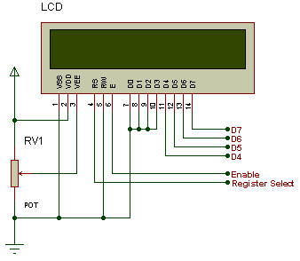
Project requirements Specifications
Microcontroller:-
Operating Frequency- 12MHz osc./clock input
Two Channel ADC (0 and 1)
UART (Baud Rate-9600)
RF Module:
RF waves are electromagnetic waves which propagate at the speed of light, or 186,000 miles per second (300,000 km/s).
LCD :-
16 character x 2 line dot matrix LCD module.
Powered by 5V DC
Can display:96 inbuilt ASCII characters,
92 special characters
8 custom characters
BACK

Slide 12

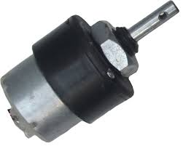
BATTERY
Specification of battery:
Operating voltage:-12vDC
Current Rating :-1.3Ahr
MOTOR
Features of the DC Motors used:
60 RPM 12V DC motors
5 kgcm torque
6mm shaft diameter with internal hole
125gm weight
No-load current = 60 mA(Max),
Load current = 300 mA(Max)
BACK

Slide 13
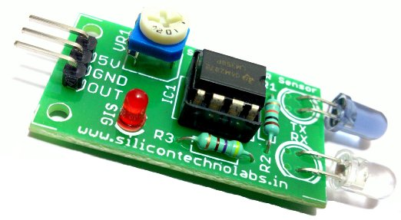
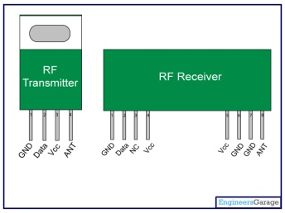
Hardware Used
PIC 16F877A :-
1. DC - 12 MHz osc./clock input
2. Compatible 10 –bit Analog-to-Digital Converter
3. Addressable USART module:
4. Supports RS-485 and RS-232
IR Sensors :
1. 38 kHz infrared IR receiver
2. Operating Current -15mA
3. Operating Frequency- 38KHz
4. Range :- 2cm to 40cm
RF Module
RF waves are electromagnetic waves which propagate
at the speed of light, or 186,000 miles per second
(300,000 km/s).
BACK

Slide 14
Software Required :-
Proteous (Simulation)
Express PCB (PCB Design)
MPLAB (Software Programming)
PIC Kit2 (For Program Downloading)
BACK

Slide 15
FLOWCHART
(CAR UNIT)
Start
Initialize the LCD display, motor move at forward
Direction
B
Check for RF Tags at 3 checkpoints
NO
NO
Check if IR1sensor is detected
Check if IR2 is detected?
Sending signal to traffic unit
YES
YES
Right side motor move 30degree
Left side motor move 30degree
B
B
BACK

Slide 16
FLOWCHART
(TRAFFIC UNIT)
Start
Initialize the LCD display
Display the Welcome message
A
Read the RF input from vehicle unit
Check if 3rd checkpoint is received?
YES
NO
Jump to Signal on which the vehicle is moving and turn that signal ‘GREEN’
Read the RF input
A
BACK

Slide 17
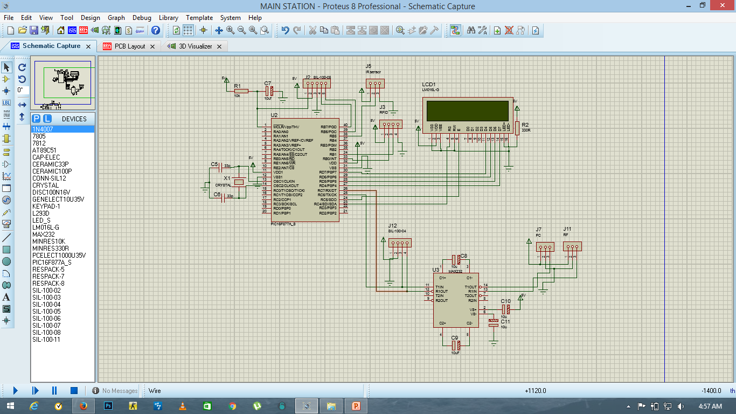
Simulation (Traffic Unit):-
BACK

Slide 18
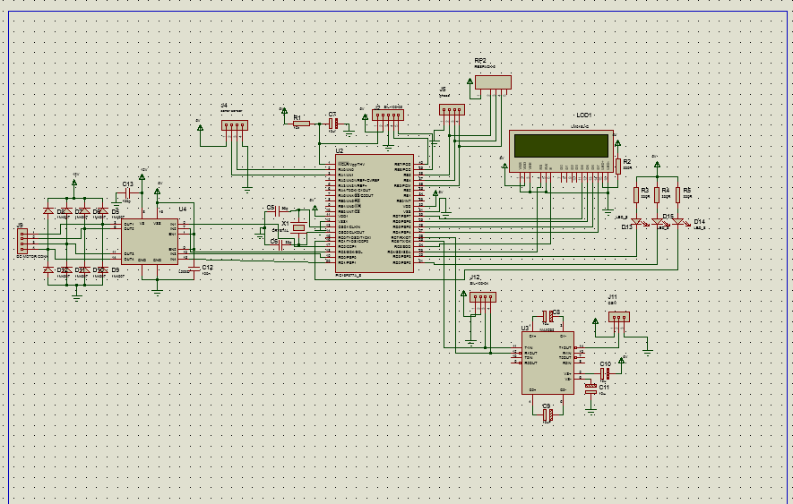
Car Unit:-
BACK

Slide 19
Results and Testing
BACK

Slide 20
ADVANTAGES
Consistent and Smoother(The performance indicators showed that the driver behavior changed and became more consistent and smother.)
Traffic Safety (Evaluate the impact of V2I communication on improving driver behavior.)
Mobility(The ability to improve traffic safety and mobility while reducing environmental impacts.)
BACK

Slide 21
APPLICATION
The safety applications aim to decrease the number of accident by prediction and notifying the drivers of the information obtained through the communications between the vehicles and sensors installed on the road.
Warning for hazardous situations (such as congestions, accidents, obstacles etc.),
Merging assistance,
Intersection safety,
Speed management,
Rail crossing operations,
Priority assignment for emergency vehicles
Traffic information
Road status information
BACK

Slide 22
Conclusion
We have presented a V2I-based traffic management system with a two fold objective: First, our approach proposes a solution to the problem of regulating traffic flow in urban areas, in which diﬀerent bottleneck situations may coexist. Second, it contributes to avoiding accidents by alerting the driver in advance of potential collisions. The system includes an intelligent controller that uses a reference safety distance and the appropriate speed as fuzzy inputs.
BACK

Slide 23
References
Links
http://www.iteris.com/cvria/html/applications/app57.html
3GPP TSG –SA WG1 Meeting #68 , San Francisco USA November 2014
http://www.radio-electronics.com/info/cellulartelecomms/lte-long-term-evolution/4g lteadvanced- d2d-device-to-device.php
http://www.nhai.org/Doc/14jul11/ETC_Specs_June%2020112828319218.pdf
WEBSITES
www.beyondlogic.org
www.wikipedia.org
www.howstuffworks.com
www.alldatasheets.com
BOOKS
projects.org, “www.projectof 8051.com,” 2011. .
M. Mazidi, 8051 Microcontroller and Embedded Systems. Pear-son Education India, 2007.

Slide 24
THANK YOU!!

Slide 25
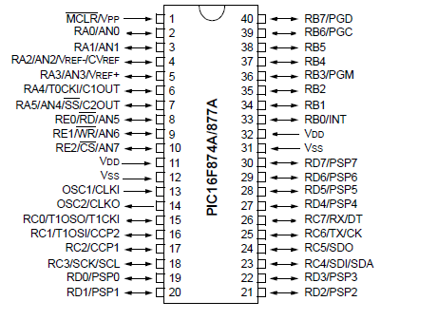
PIC microntroller
BACK

Slide 26

Crystal circuit
Working: - The circuit consists of one crystal and two capacitors. The crystal is used to give the microcontroller the required periodic pulses to make it function properly. The crystal used in the project is of 12 MHz. The two capacitors are connected to two pins of the crystal and are grounded at the other ends
BACK

Slide 27
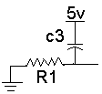
Reset circuit
This circuit gives the microcontroller the starting pulse required to start the operation from the start. Unless this pulse is given, the microcontroller doesn’t start functioning.
The circuit gives the required starting pulse to the microcontroller to start the operation from the very beginning. The 89S51 microcontroller requires the active high reset pulse. So the capacitor is connected to positive supply and the resistor is grounded.
BACK

Slide 28
LCD
BACK

Slide 29
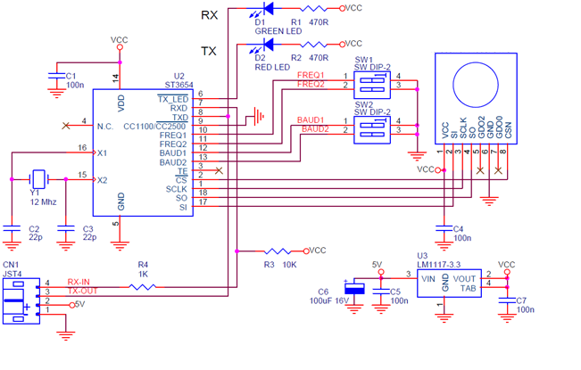
RF module
RF modem can be used for applications that need two way wireless data transmission. It features adjustable data rate and reliable transmission distance. The communication protocol is self controlled and completely transparent to user interface. The module can be embedded to your current design so that wireless communication can be set up easily.
BACK

Slide 30
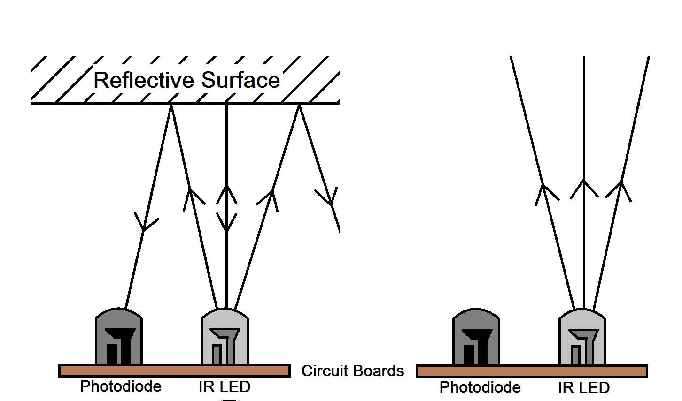
IR SENSOR
.
BACK

Slide 31
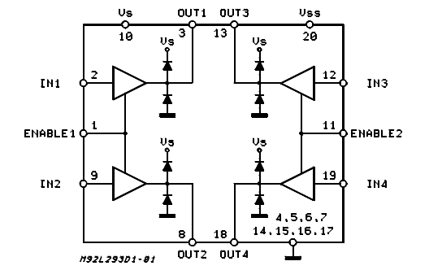
Motor driver
BACK

Slide 32
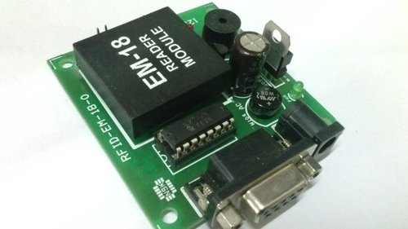
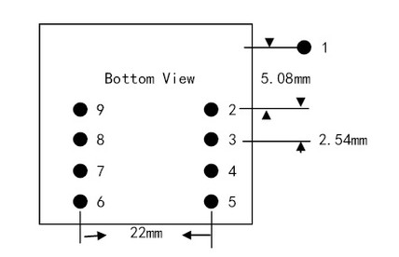
EM- 18 MODULE
Speciﬁcations:
5VDC through USB (External 5V supply will boost range of the module) Current: ¡50mA Operating Frequency: 125Khz Read Distance: 10cm Size of RFID reader module: 32mm(length) * 32mm(width) * 8mm(height)
RS232 interface format: 10 ASCII DATA (card no.)+ 2 ASCII DATA (XOR result) E.g. Card number is 4500C5D1E9B8 read from reader then the card number on card will be as below. Preamble 00C5D1E9 value in Hex = 12964329. / B8 is XOR value for (45 XOR 00 XOR C5 XOR D1 XOR E9) Hence number on the card is 0012964329. 1. Data baud rate: 9600 bps 2. Data bit 8 bits 3. Parity check: None 4. Stop bit
Thus we understood the diﬀerent components used in power supply design, we also studied diﬀerent components and modules required in the designing the system.

